Slide 1
C and Interview Masterclass

Slide 2
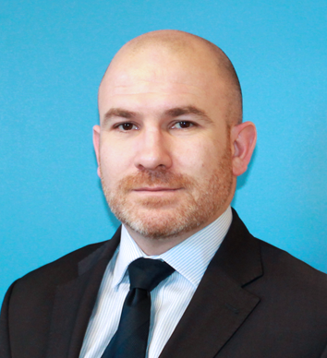
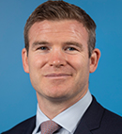
You’ve Secured the Interview - Now What?
Cathal O Donnell
Regional Director, Brightwater Group
Gordon D’Arcy
Commercial Director, Brightwater Group

Slide 3
Agenda
Preparing for Interview
Virtual Interviews
1st Impressions
How To Answer Questions
The Close
Common Interview Mistakes

Slide 4
On Interview Day
Things to remember on Interview day
Have researched the company
Have researched the role
Have researched the interviewers
Bring any related documentation
Prepare sample questions that you want to ask
Make sure you have the exact location/travel time/virtual set up

Slide 5
Virtual Interviews
Treat the interview with the same respect
Practice with Zoom, Teams, Facetime, WhatsApp
Positioning of the screen and camera
Phone vs Laptop
Lighting and surrounding area
Noise and sound
Software upgrades on your laptop
Body Language
Eye contact
Hand movement
Empty stare
Forgetting the camera is on
Taking notes
Distractions – children, pets, the doorbell

Slide 6
The Introduction
Presentation
The power of a smile
Set the atmosphere
Build rapport
Confidence v Arrogance
Display your desire to be there

Slide 7
The Interview
Know your CV
Listen to what is being asked
Sell to the clients needs
It’s about what you have, not what you don’t
Have your questions prepared
Speak to all members of the panel
Try and enjoy it
Use the words “enjoyed” ”successful” and “help”
“While I was preparing” “while I was researching”
10/20/30/40 model of answering questions
Competency based questions

Slide 8
10/20/30/40 Model

Slide 9
Competency Based Questions
Questions around what you have done that demonstrate the key characteristics their organisation’s need for this role
Organisation Awareness
Describe your current company and give examples of how you work within its culture
Describe how you perceive our company and how you would fit in.
Strategic Thinking
Describe the most challenging aspect of your current role and how you have adapted your performance
How did you go about assessing your own performance and that of your team?
Innovation
Describe something new that you have done for your company that improved performance
Have you done anything innovative that would be of direct interest to your current market?
Communication
Give examples of a difficult situation that required your excellent communication skills
How have you developed communication skills in others?

Slide 10
Competency Based Questions (2)
Questions around that you have done that demonstrate the key characteristics their organisation needs for this role
Leadership Ability
Describe how you lead your team
How do you motivate your team?
Team Work
Describe a situation where you were a member of a team
What did you do to make a positive contribution?
Time Management
Give examples of meeting deadlines
If a deadline was missed, how did you react to that?
How do you improve your team’s performance?
What would your team say about you?
Describe a situation where there was conflict – what did you do to resolve it?

Slide 11
The Close
Finish off with any outstanding questions
Make sure you have covered all aspects YOU wanted to cover
If you want it, ask for it. This is your best opportunity
“I really enjoyed that meeting and thanks for all the information you gave me. Just before I go I wanted to let you know that I’m genuinely interested in this role and am looking forward to hearing from you.

Slide 12
Common Mistakes
Don’t oversell
Don’t volunteer unnecessary information
Try not to tangent
Don’t sell what you have, sell what they need
Don’t be late!!
“Where do you see yourself in 3 years’ time?”
“Where do you see your career going”
“What does success mean to you”

Slide 13
Questions?
For further information or for a confidential conversation,
please contact Cathal O Donnell
on + 353 1 6621000 or c.odonnell@brightwater.ie

